Slide 1


DEPARTMENT OF COMPUTER SCIENCE AND ENGINEERING
CSB1303 – OBJECT ORIENTED ANALYSIS AND DESIGN (TCPR)
ACADEMIC YEAR : 2025-2026(ODD SEMESTER)
III YEAR / V SEMESTER
Register No. : 927623BCS040
Name : Jeeva S
Date : 26.08.2025

Slide 2
TITLE OF THE PROJECT
Retail Chain Inventory Tracker

Slide 3
PROBLEM STATEMENT
Large retail chains with multiple stores struggle to maintain accurate, real-time inventory counts.
Stock inconsistencies across outlets and delayed reporting cause stockouts, overstocks, lost sales, and poor replenishment decisions.
A centralized system with timely synchronization and consolidated reporting is needed.

Slide 4
OBJECTIVE
Design an object-oriented model to enable centralized inventory tracking across multiple retail stores.Ensure near real-time synchronization of stock levels between stores and the central server.Provide role-based access (store manager, warehouse, admin) and reporting dashboards (stock, sales, reorder alerts).Support multi-store transfers, purchases, returns, and automated reorder suggestions.

Slide 5
ABSTRACT
This project develops an object-oriented solution for a Retail Chain Inventory Tracker.
The system models stores, products, stock-keeping units (SKUs), transactions, and users as objects.
It supports real-time sync between distributed store nodes and a central server, provides reporting and alerts for low stock, and facilitates inter-store transfers and automated reorder logic.
Emphasis is on modular OO design, UML diagrams, and use-case driven development.

Slide 6
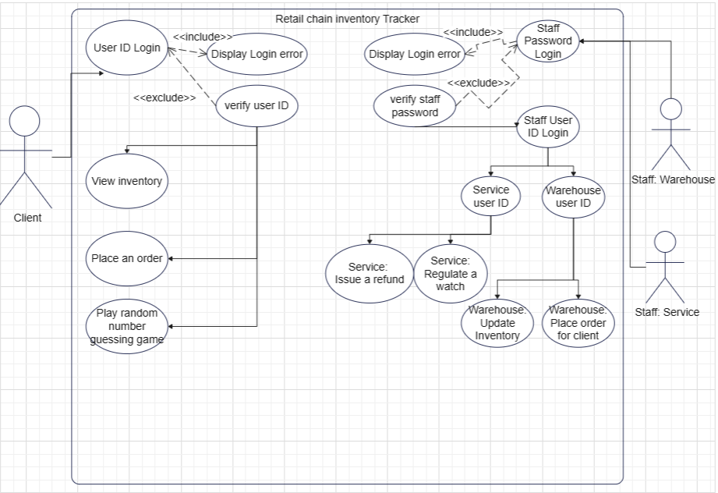
USE CASE DIAGRAM

Slide 7
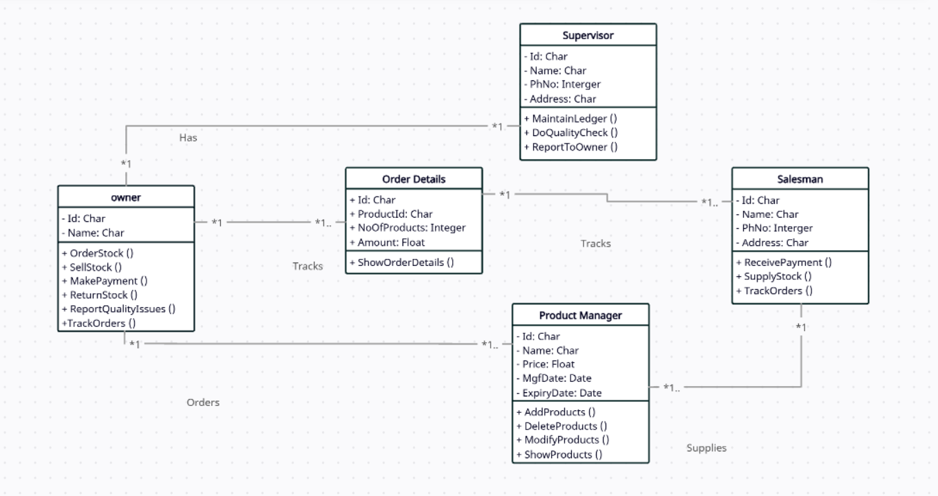
CLASS DIAGRAM

